Slide 1

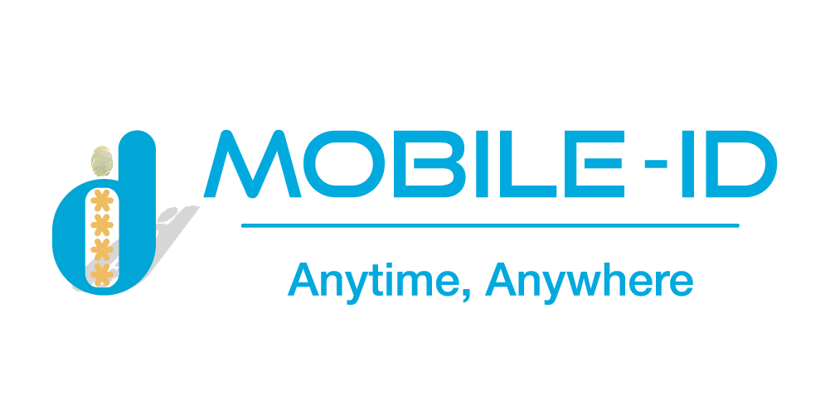

OVERVIEW
GOPAPERLESS
Online identity verification and signing platform with full optimal features

Slide 2






CONTENTS
WHY GOPAPERLESS ?
GOPAPERLESS SYSTEM OVERVIEW
GOPAPERLESS SOLUTIONS
FEATURES OF GOPAPERLESS

Slide 3
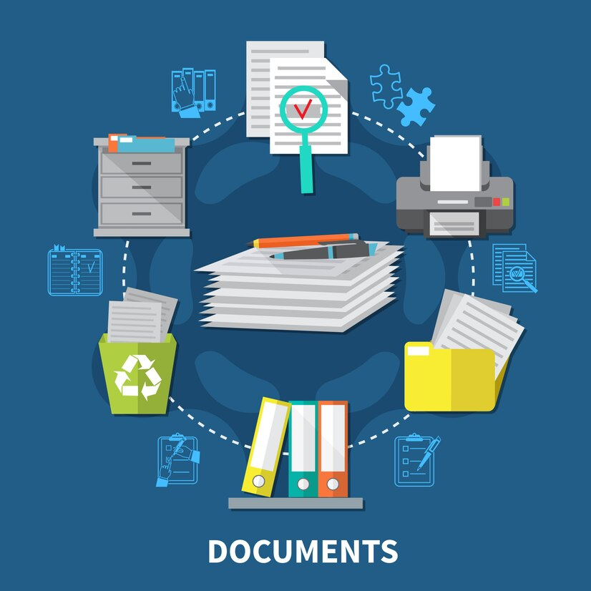



NORMAL SIGNING PROCESS
Prepare documents
Printing
Signature
Record-keeping
Documents will have to be printed before being summited for signature
Expensive printing costs, paper waste and processing costs
The documents will need to be sent directly to each signer and requires time to wait for approval
The signing process is complicated and takes a lot time. The documents are susceptible to information theft, edit and signature forgery
The documents will need to be store, preserve and securely managed
Needs storage space and low security, difficult in information management
Notes:
Quá trình ký tài liệu thông thường hiện đang có nhiều vấn đề bất cập: Thời gian, chi phí và tính an toàn, bảo mật thông tin. Ngoài ra, việc lưu trữ cũng như xử lý hồ sơ cũng đang là một vấn đề đang được quan tâm hiện nay.

Slide 4


Notes:
Nắm bắt được các vấn đề trên, Mobile-ID đã xây dựng lên dịch vụ GoPaperless và đây chính là giải pháp hợp lý nhất cho quy trình ký tài liệu hiện nay.

Slide 5

INTRODUCTION
PURPOSE
OVERVIEW
To save time, and costs, increase the ability to manage, store, and secure information, digital transformation is indispensable and “Electronic identity” is also a necessary need today.
It can be seen that to sign a contract, financial report, etc., verifying personal identity and legal signature using a manual process will require many procedures, time and cost. From the above issue, the GoPaperless electronic identification and signing platform was born so that simplifies a paperless document signing process.
At GoPaperless, all e-signatures are created using high-assurance eIDs and meet the strictest requirements set forth under the EU eIDAS regulation.
Create an online signing and verifying identity platform with all of the optimal features, specifically:
GOPAPERLESS SYSTEM
Enables quick, efficient online approval of any business document, agreement, report, request, or package;
Cuts time, reduces costs and adds strong controls to minimize signing errors;
Ensure traceability, accountability and audit with clear legal weight, data integrity and individual signed approval together with easy to access workflow process evidence;
Can be shared, viewed, and signed on any device, anywhere, anytime in a way that suits any approval process.
Notes:
Với GoPaperless, các vấn đề bất cập trên đã được đơn giản hóa và tối ưu. Cùng với mục tiêu của GoPaperless mà Mobile-ID hướng đến.

Slide 6


OVERVIEW GOPAPERLESS SYSTEM
Equal to handwritten signatures
Tamper-proof documents
Legally binding
Real e-signatures
Supported Qualified Electronic Signatures are equal to handwritten signatures
All documents signed in GoPaperless are secured against forgery and backdating
Supported e-signatures are legally binding and accepted across the entire Vietnam
Electronic signatures are not scribbled images on a document
GoPaperless is a java web application that runs on Linux Servers. GoPaperless provides user management, document and workflow management, auditing, and optional billing. It uses Mobile-ID’s other strategic product, Trusted Hub Service Provider Appliance, to provide all the advanced cryptographic services such as central or local signing, key generation, certificate management, Interfaces to internal or external CA (Certification Authority), OCSP (Online Certificate Status Protocol) and TSA (Time Stamp Authority) services. Trusted Hub Service Provider Appliance can be deployed on Linux Servers.
With GoPaperless’s mobile app get all the awesome portal features on the go plus instant notifications about what’s going on with your documents right to your mobile phone.
Notes:
Giới thiệu về GoPaperless

Slide 7


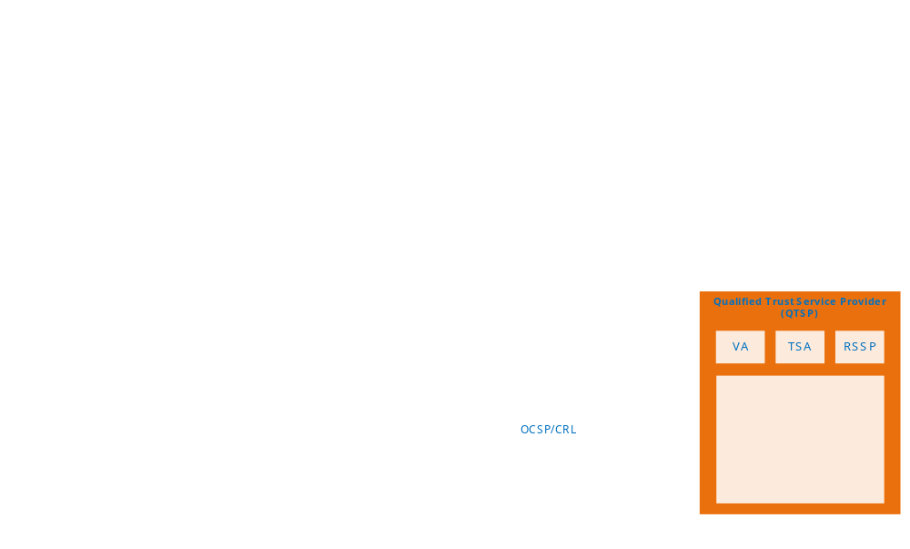
OVERVIEW
GOPAPERLESS SYSTEM ARCHITECTER
External System
Bank, judicial, etc.
Business
Mobile-ID’s Internal System
CUSTOMER
eTax, eContract, eInvoice, Qrypto, CheckID, eKYC, etc.
Personal
Mobile-ID’s staff
Sales, Admin, customer support staff, etc.
Notes:
Giới thiệu về kiến trúc hệ thống GoPaperless

Slide 8
GOPAPERLESS &
TRUSTED HUB SERVICE PROVIDER APPLIANCE
Document categories
GoPaperless & Trusted Hub Service Provider Appliance Components
Notes:
Giới thiệu sơ đồ tích hợp GopPaperless và Trusted Hub ….
(GoPaperless is easy to install and configure. Some initial discussions with Mobile-ID or its partners may be useful to understand which of the available options best suits the business’ needs. This diagram shows how GoPaperless and Trusted Hub Service Provider Appliance work together with various potential business applications. All user and document management are handled inside GoPaperless, whilst all user key management and cryptographic operations are processed within Trusted Hub Service Provider Appliance.
Either a full internal PKI or one (or more) external PKIs can be used. Trusted Hub Service Provider Appliance can either be deployed on the same or different site. This latter option allows GoPaperless to be deployed on premises whilst all the user keys are held within an ISO 27001, SSAE 16, SOC 2 datacenter.

Slide 9






IDENTIFICATION
PLATFORM
PERSONAL IDENTITY
BUSINESS IDENTITY
STEP 1
STEP 2
STEP 3
Face authentication
4 factors authentication
via Finance
3 factors authentication
via service provider
Verify business
Representative information
Check company
information
Authorization
authentication
Check Liveness
Compare with portrait photo
Compare with Citizen Identity cards
Verify national data
Check full name
Check ID Card/ Citizen ID card number Check financial status
Check taxpayer status
Check full name
Check ID Card/ Citizen ID card number
Check phone number
Face authentication
4 factors authentication via finance
3 factors authentication via service provider
Company’s name
Company registration certificate number
Information on company status
Authorization legal representation
Sesame enterprise certification?
Deposit money into company account?
Notes:
Giới thiệu về nền tảng xác thực của cá nhân và doanh nghiệp

Slide 10

FULL PROCESS SIGNING PLATFORM
Service Provider
Signer
Verify identity
Confirm contract
Sign
Digital
contact
Authenticate
Manage contact
Electronic deposit
Legal service
Verify individuals
Verify enterprise
Ensure the accuracy of identity information by using services such as eKYC, OTP, etc.
Sign: Ensure the signer’s wishes via letter of commitment, confirmation
Deploy electronic contract on industries ecosystem platform: Banking, Electronic Commercial, Real Estate, Automotive, etc.
Template of contract, condition Monitor contract
Provide deposit, certificate of deposit service Notarize, authenticate contract
Notes:
Giới thiệu về nền tảng toàn bộ quy trình ký

Slide 11

eRequest
eFlow
GOPAPERLESS SUBSYSTEM
eAnalysis
eProcess
eID
Virtual Collaboration
GOPAPERLESS
eBilling
eRegistry
eWriter
eAccount
eNotary
Notes:
Giới thiệu về các hệ thống con trong GoPaperless

Slide 12
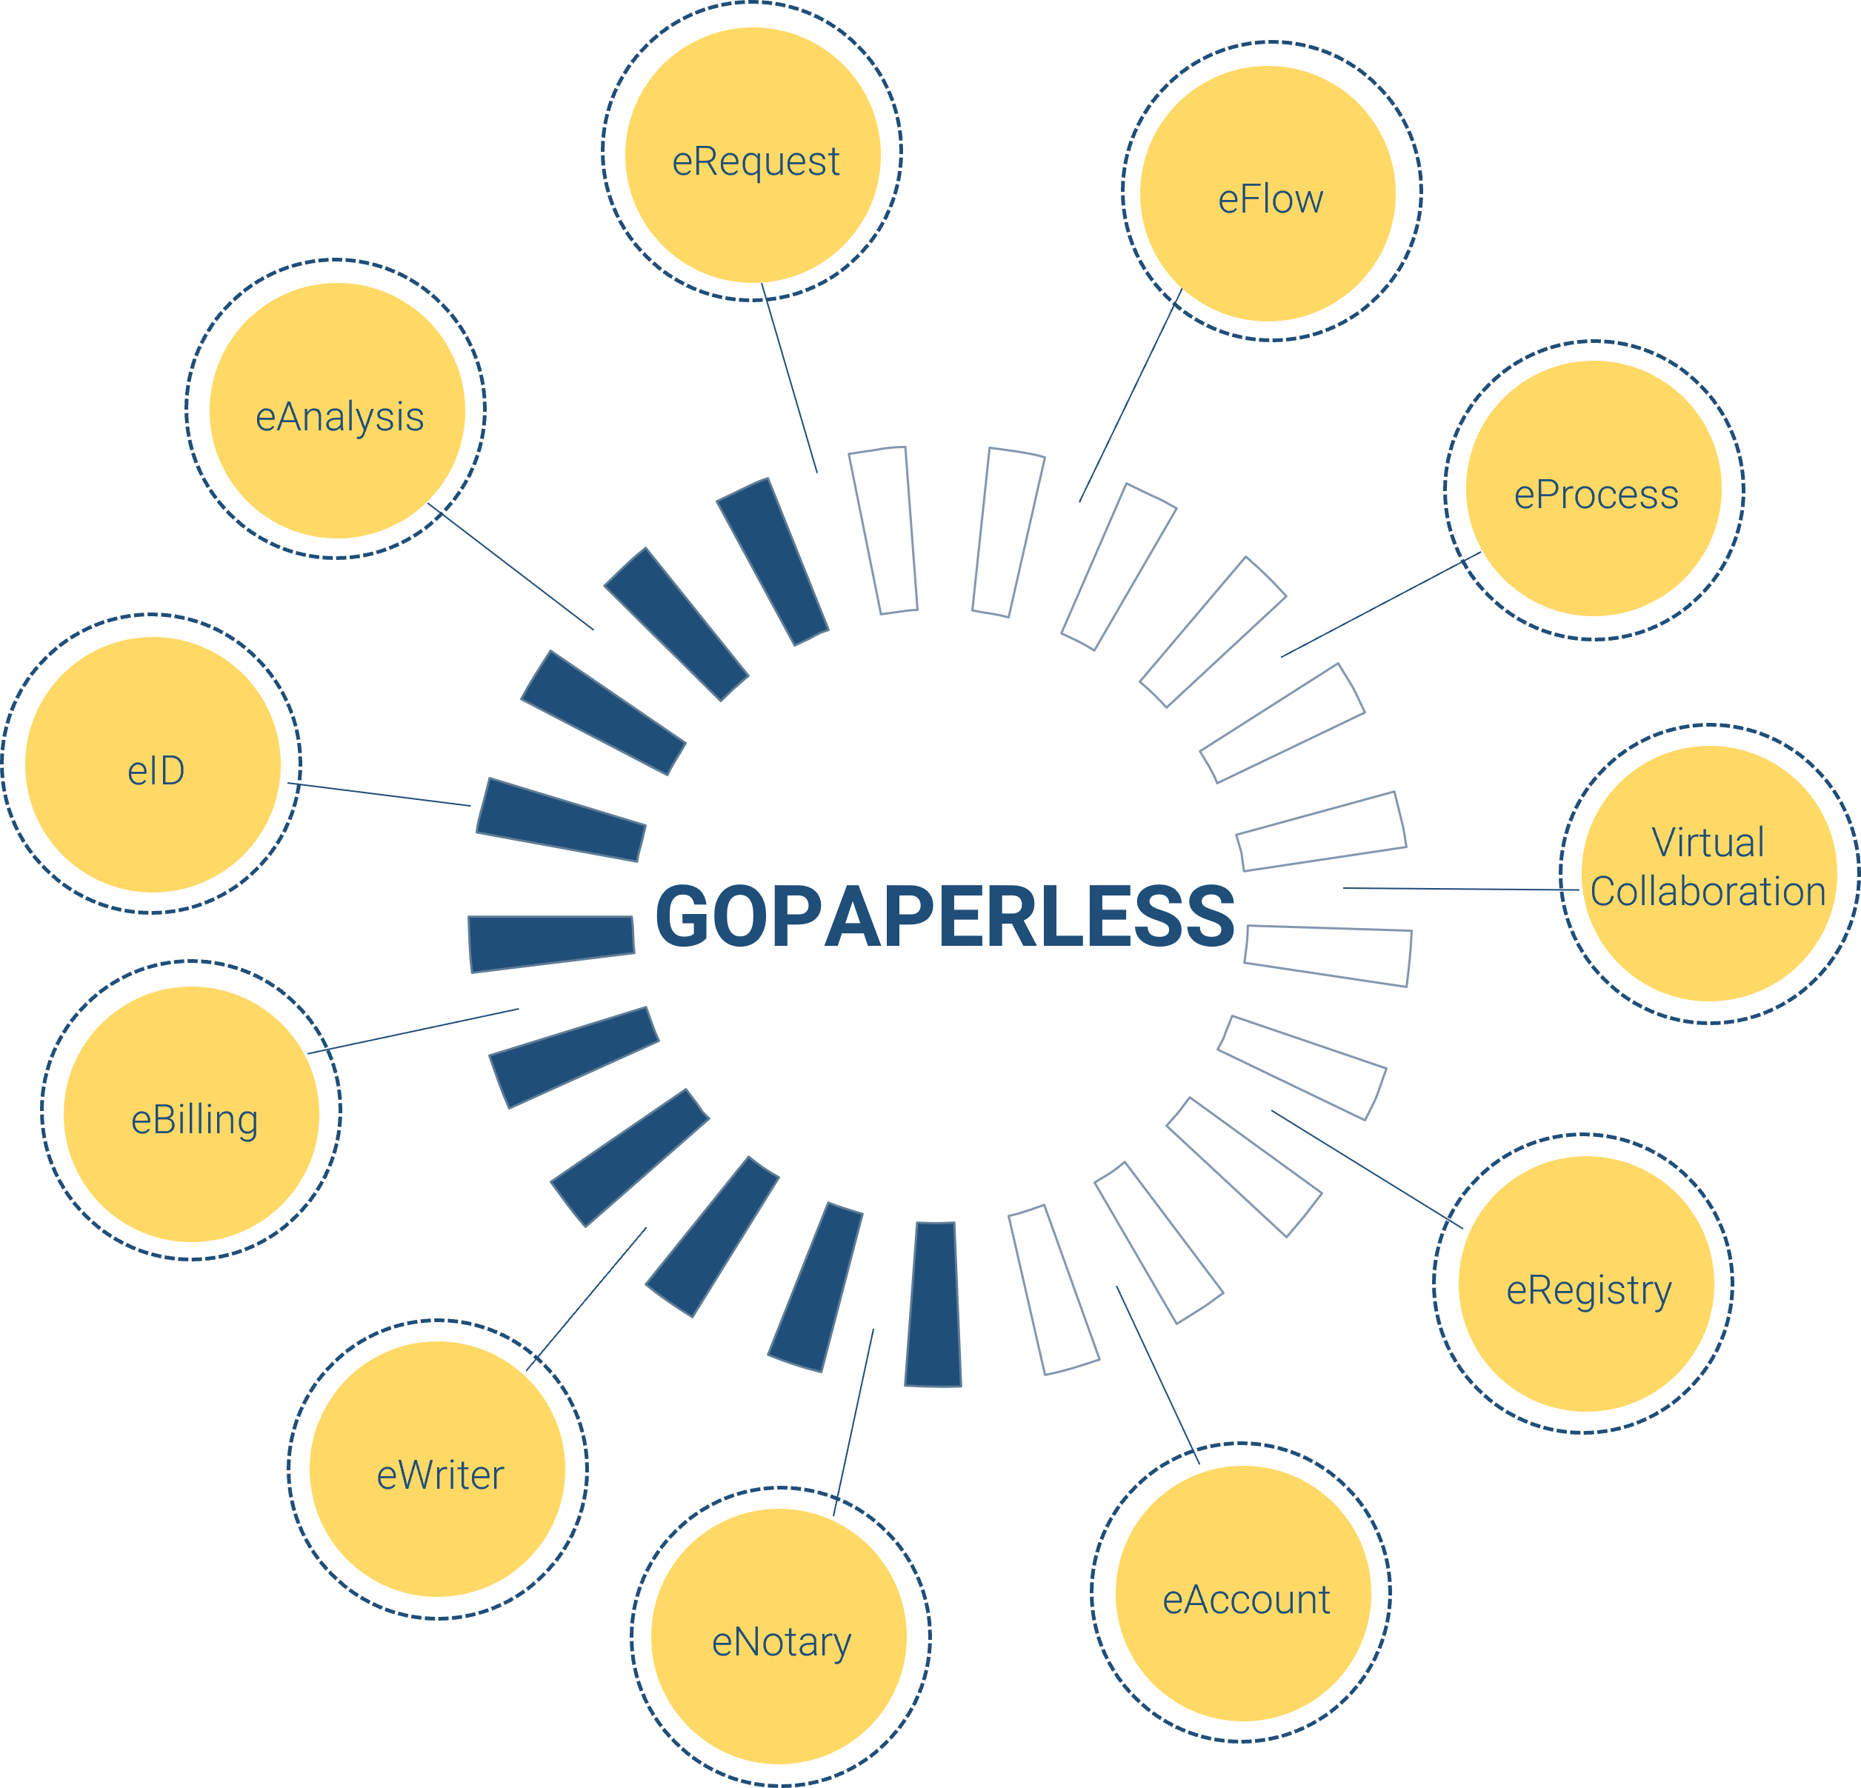
FULL PROCESS SIGNING PLATFORM
eAccount: Centralized account management subsystem
eRegistry: Service registration subsystem
eRequest: Ticket, ticket status management subsystem
eFlow: Subsystem for creating eForm and configuring workflow
eProcess: Subsystem for linking and publishing workflows
eID: Citizen’s identity information management subsystem
eNotary: Electronic notary subsystem
Virtual collaboration: Virtual collaboration module, allowing online contract negotiation, meetings, calls, chat
eAnalysis: Statistical analysis subsystem provides reports related to fields on the system
eBilling: Billing management subsystem
eWriter: Subsystem for editing and creating variables for documents with the purpose of exporting to another system to get the corresponding data variables

Slide 13

GOPAPERLESS
SOLUTIONS

Slide 14





CREATE A NEW WORKFLOW AND
SIGN ON GOPAPERLESS GATEWAY
A Service Gateway for Enterprises that initiates a digital signature flow for a group of digital signature users, specifically signing on a document that has been uploaded to the system. Here, the user will choose one of the signing methods (Smart-ID, USB Token, Electronic-ID, ...) to digitally sign the document based on the shared gateway view page.
Document categories
Sign by
Sign by
Sign by
Sign by
REMOTE SIGNING
USB TOKEN
ELECTRONIC-ID
INTERNAL SIGNING SERVICE
Notes:
Khách hàng sẽ ký thông qua cổng ký GoPaperless và tại đây, có nhiều lựa chọn cho việc chọn hình thức ký: USB Token, Smart-ID, Electronic-ID.

Slide 15
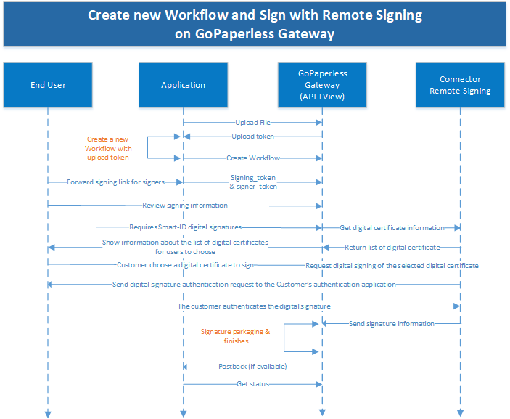
Sign by
REMOTE SIGNING
Notes:
Ngoài ra, KH còn có thể ký với Remote Signing (mô tả luồng và trình chiếu video demo)

Slide 16
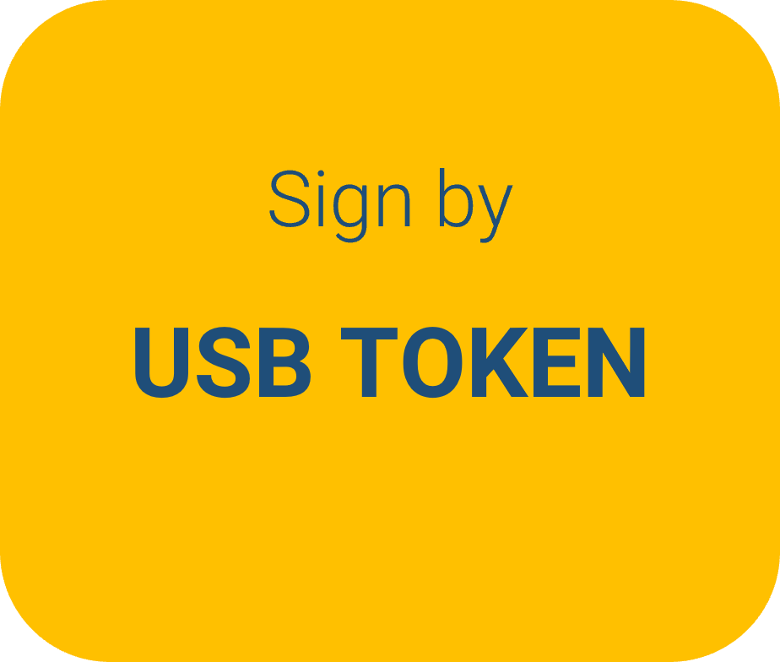
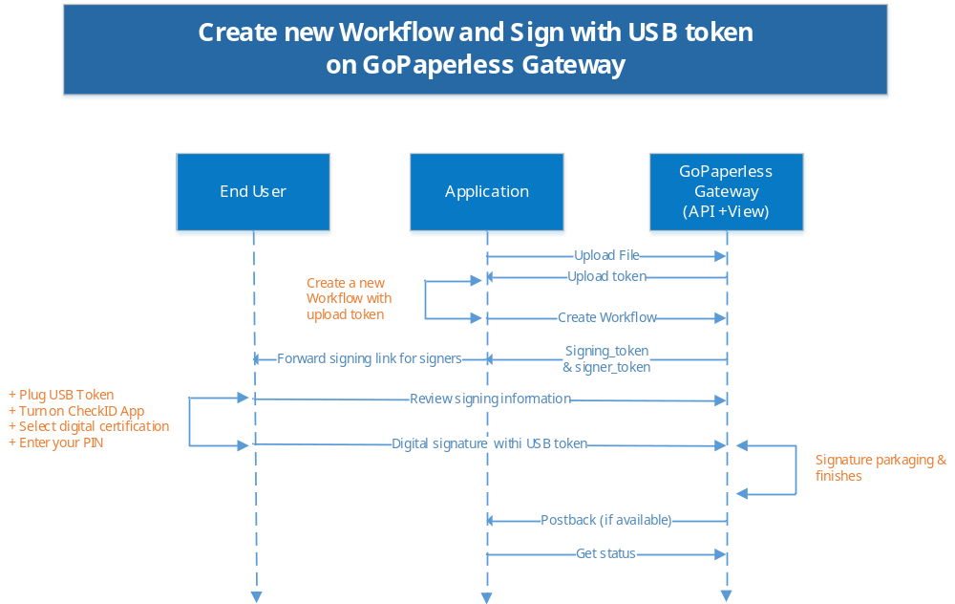
Notes:
Mô tả luồng ký với USB Token và trình chiếu video Demo để KH hiểu được quy trình ký bằng USB Token.

Slide 17
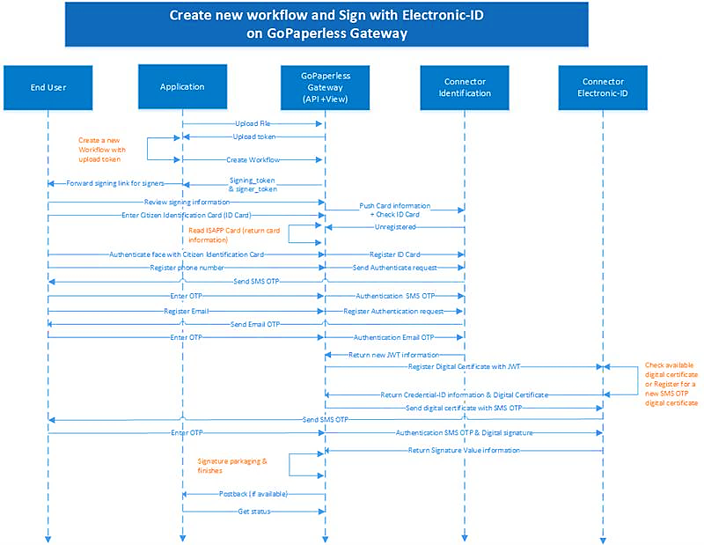
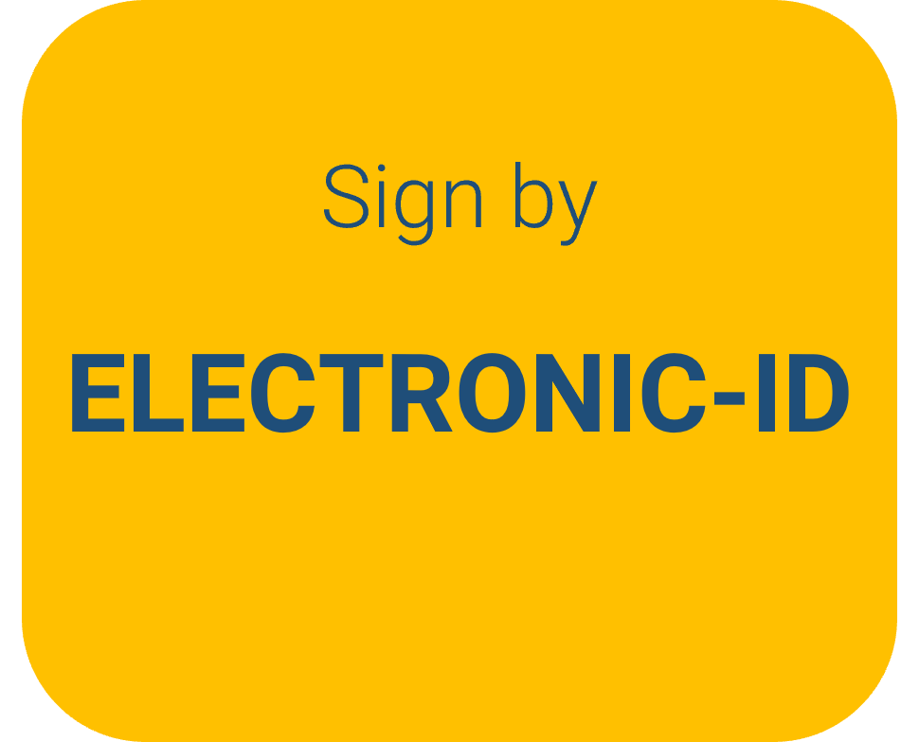
Notes:
Giới thiệu về luồng người dùng chưa có tài khoản và đã có tài khoản
Điểm vượt trội là có thể sử dụng thêm Face-ID để xác minh tính xác thực

Slide 18
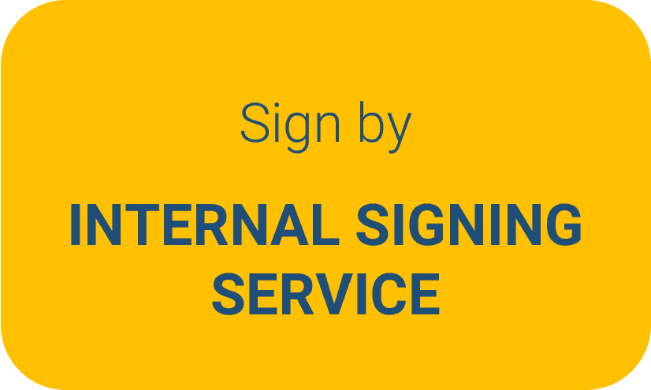

AUTHENTICATION MODES
PIN CODE
OTP CODE
BIOMETRIC
Set during the issuance of digital certificates and private keys
Sent to the user's mobile device or email and valid for < 01 minute only
Use biometric features like fingerprints, facial recognition, or iris scans for authentication
Notes:
Giới thiệu về luồng người dùng chưa có tài khoản và đã có tài khoản
Điểm vượt trội là có thể sử dụng thêm Face-ID để xác minh tính xác thực

Slide 19

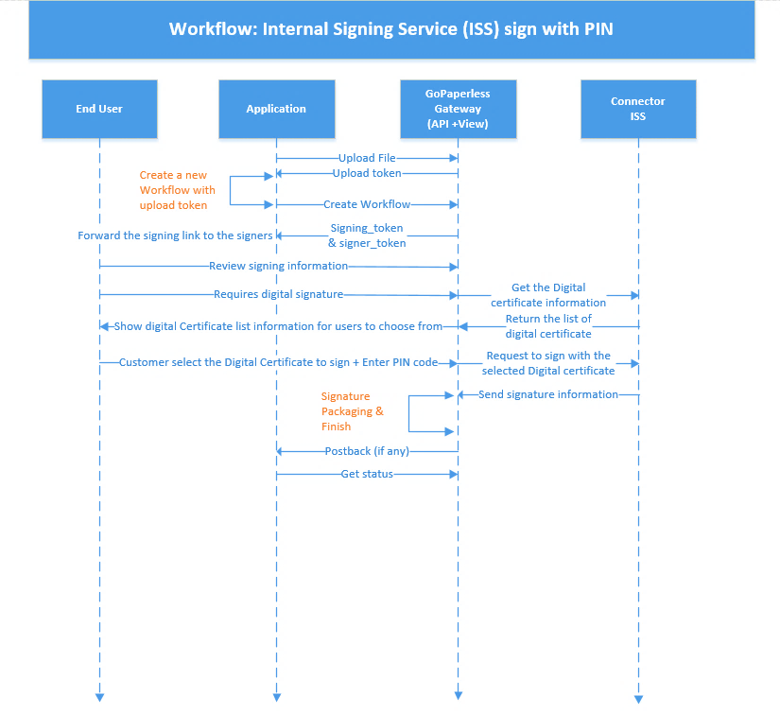
PIN OTP

Slide 20
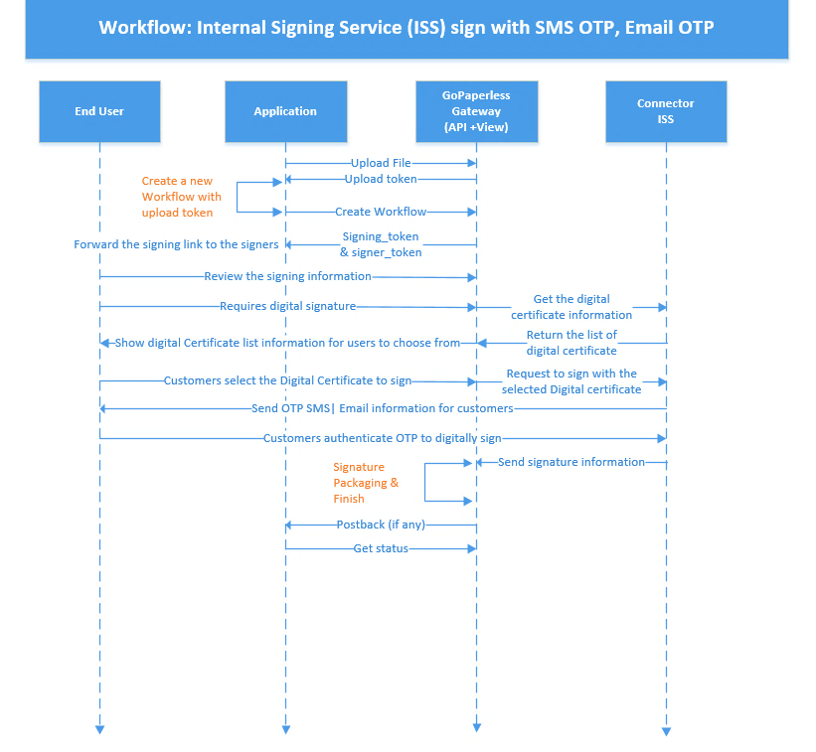
OTP CODE

Slide 21
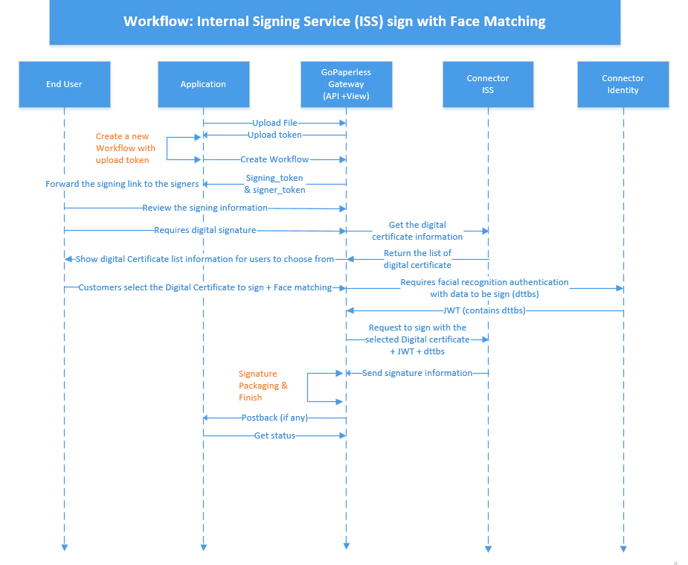
BIOMETRIC

Slide 22

FEATURE OF GOPAPERLESS SYSTEM

Slide 23










FEATURE OF GOPAPERLESS SYSTEM
Use cases
Convenient
Integrated model
Model deployment
Wide customer base: Bank, telecommunications, etc.
Connect to many CA providers, types of digital signatures
Use API or iFrame, speed up integration and easy of maintenance
Can be On – Premise to protect information for end customers
Notes:
Giới thiểu về các tính năng nổi bật mà Mobile-ID xây dựng cho hệ thống GoPeperless

Slide 24
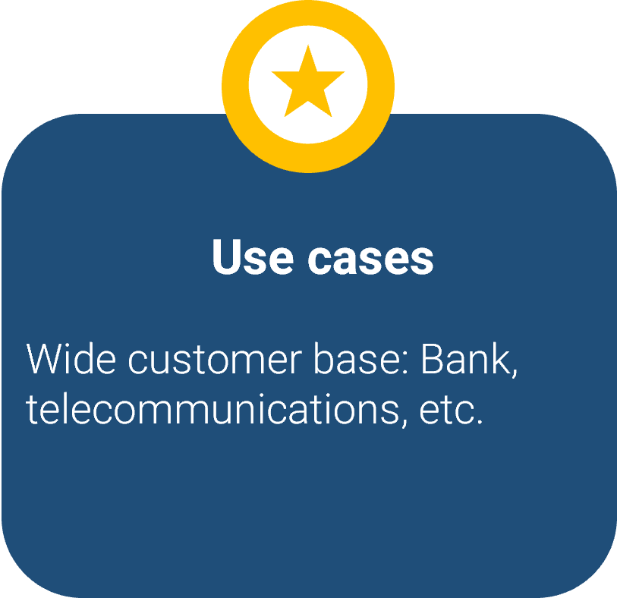








FEATURE OF GOPAPERLESS SYSTEM
INDUSTRIES
DEPARTMENTS
Financial
Human Resources
Financial
Sale
Public
Legal
Customer Service
Telecommunications

Slide 25

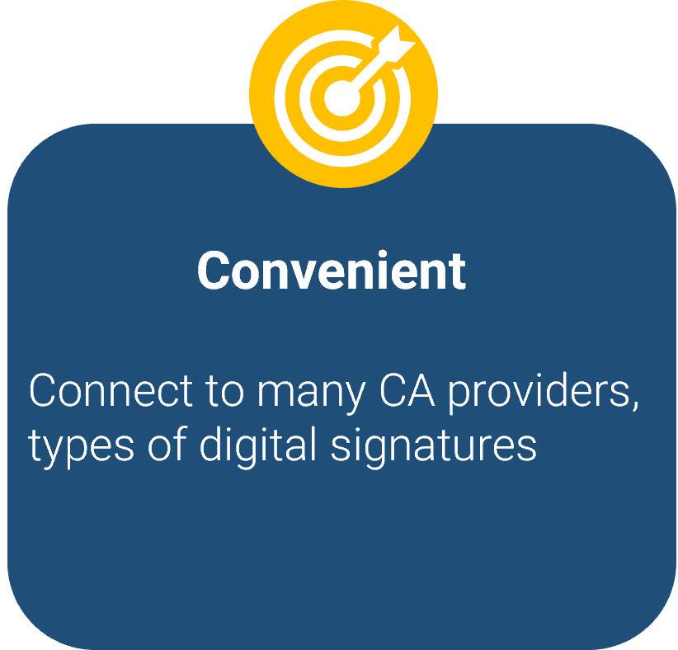










FEATURE OF GOPAPERLESS SYSTEM
Integrates and signs with most Certificate Authentications (CA)
Many options for digital signature user
USB Token
Smart-ID
Electronic-ID

Slide 26
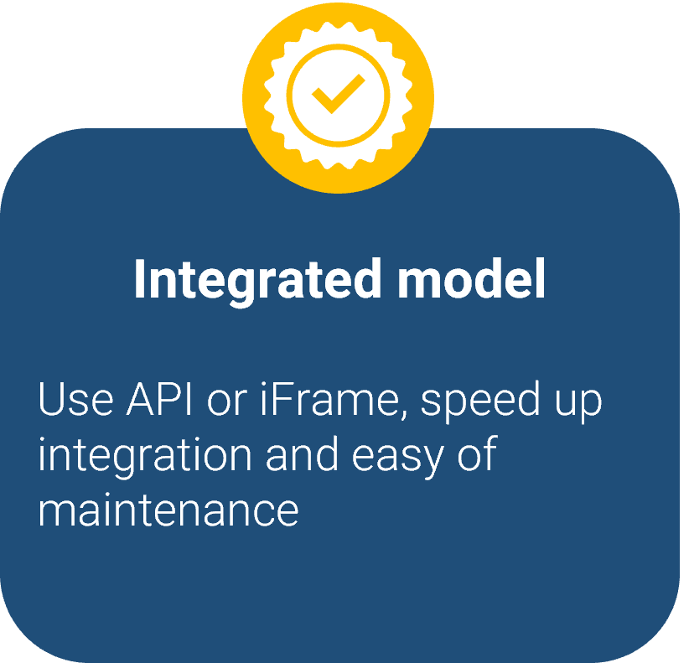
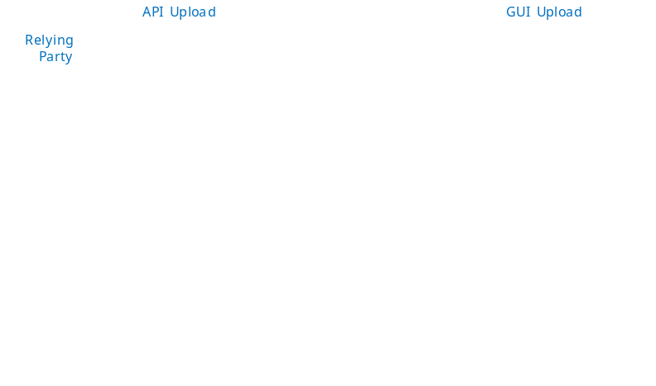




FEATURE OF GOPAPERLESS SYSTEM
GoPaperless can be driven both by human interaction and by RESTful (REpresentational State Transfer) API (Application Programming Interface) calls from any business application
Developer-friendly integration
APIs are built so that your in-house development team or any integration service provider can easily integrate a chosen API into your information system
Signature Collection
Signing
Identification
Sealing
API for collecting signatures from third parties remotely
APIs for signing, archiving, timestamping and validating documents
APIs for authenticating users USB Token, Smart-ID, Electronic-ID
API for Sealing documents as legal person to ensure their origin and integrity

Slide 27
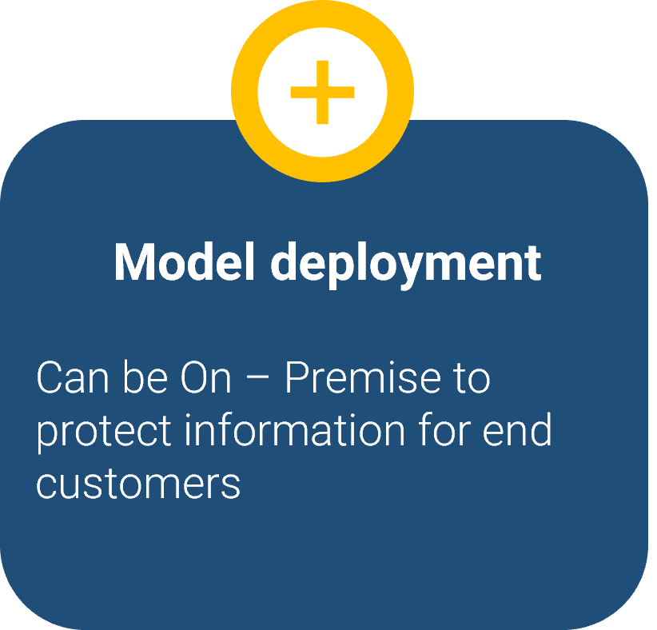
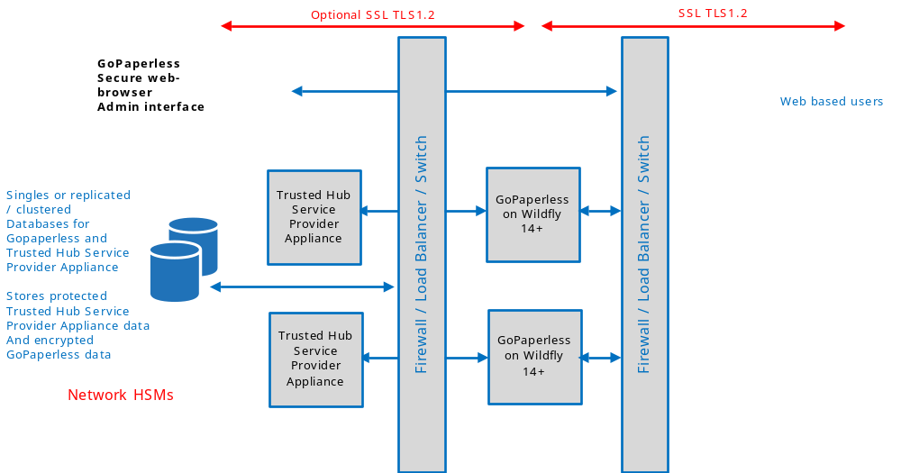
FEATURE OF GOPAPERLESS SYSTEM

Slide 28











FEATURES OF GOPAPERLESS SYSTEM
Variety of document formats
Variety of signing
solutions
Signature validation
Address book and
contact categories
Sign documents in whatever format you need — from PDF
Sign documents with your preferred eID solution, whether it’s a national ID card, Mobile ID or other
Check whether signatures from other parties are valid and legally binding
Save contacts to an address book to easily find them next time you need to share a document
Search and filter
Comments
Batch actions
Secure sharing
Filter documents by categories and search to quickly find what you are looking for
Discuss important topics and leave notes for other signing parties
Sign, delete or download all selected documents with just one click from a single location
Only intended persons who authenticate with an eID matching that person can access documents
Multilingual interface
Automatic notifications
Audit trail
Use GoPaperless in English, Vietnamese. More languages coming soon
Get informed when your signature is needed or when other parties have signed the document
See all actions performed by the users through a detailed list of events
Notes:
Bên cạnh đó, GoPeperless còn có các tính năng khác …. (mô tả sơ lược)

Slide 29







FEATURES FOR TEAM
Smooth and organized document signing process
Easy and orderly document management
Approvals
Document categories
Add additional consents to the documents to make sure they are viewed and confirmed by the responsible person before signing
Sort documents into categories for a more convenient and orderly experience
Workflows
Permissions based on categories
Create a sequence of actions for every signing party to make sure the document signing process is well-rounded and in order
Manage user rights to edit, share or delete documents assigned to categories
Deadlines and reminders
User roles
Set deadlines and additional reminders to make sure other parties sign
on time
Apply different roles for users: they have to sign a document or can only view it
All your company data at your fingertips
Company data
Centralized billing
Separate Accounts
Easily manage accounts of your team members and document access rights using centralized controls to make sure sensitive documents stay in the right hands
Reduce time spent on paying separate invoices. You can give each team member their own GoPaperless account, and pay for everything with a single invoice
Use different accounts for company and private purposes in order to separate document ownership, intended usage and costs.
Notes:
Ngoài ra, GoPaperless còn có các tính năng dành cho nhóm… (mô tả…)

Slide 30
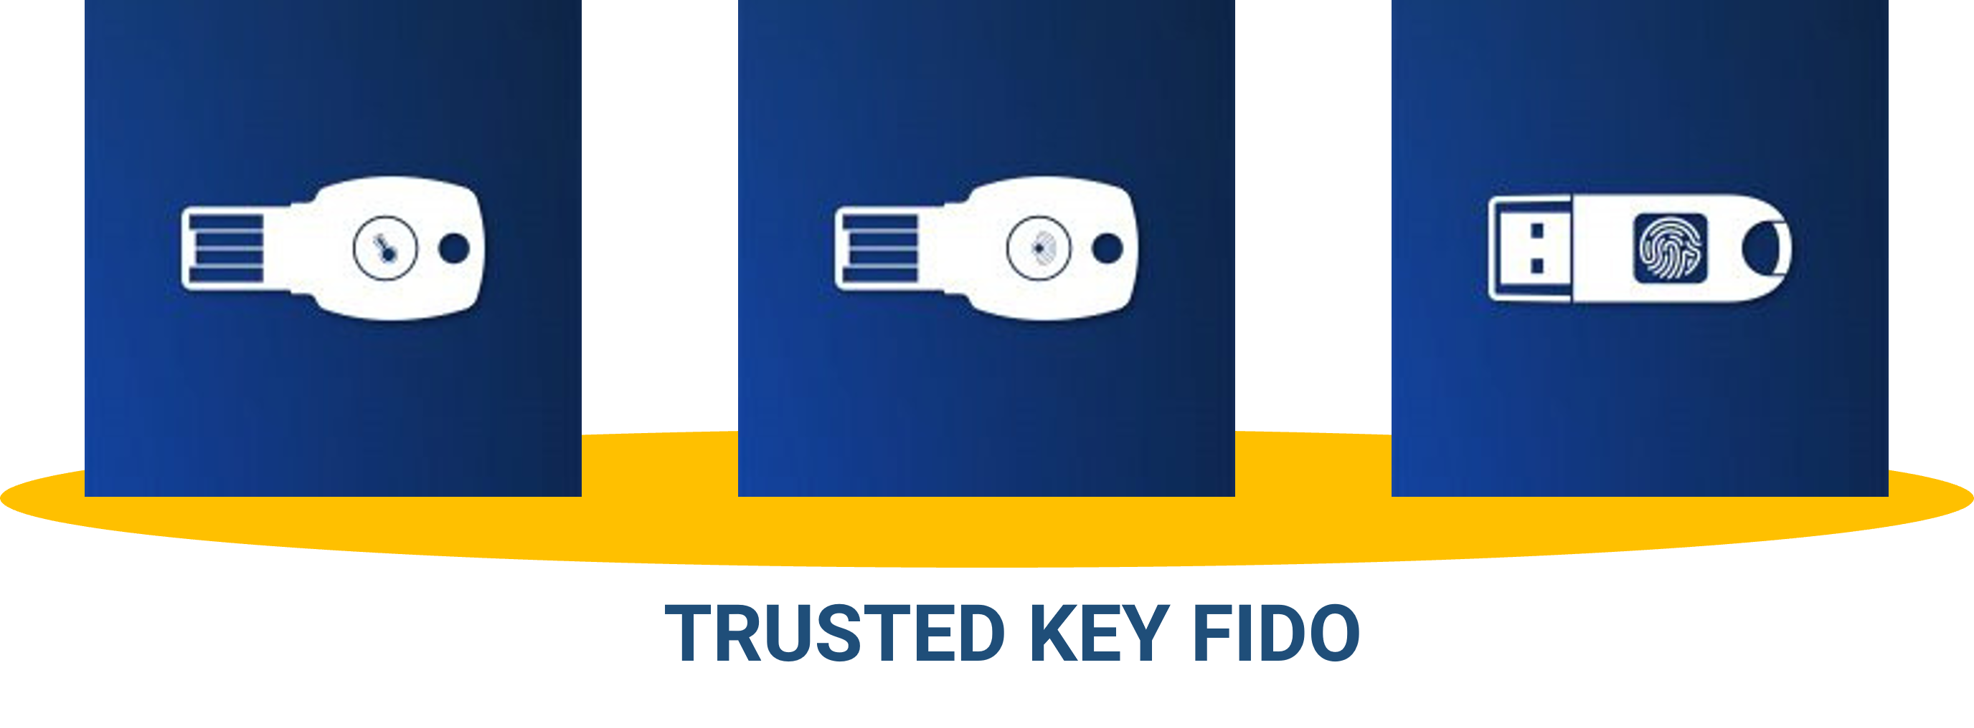
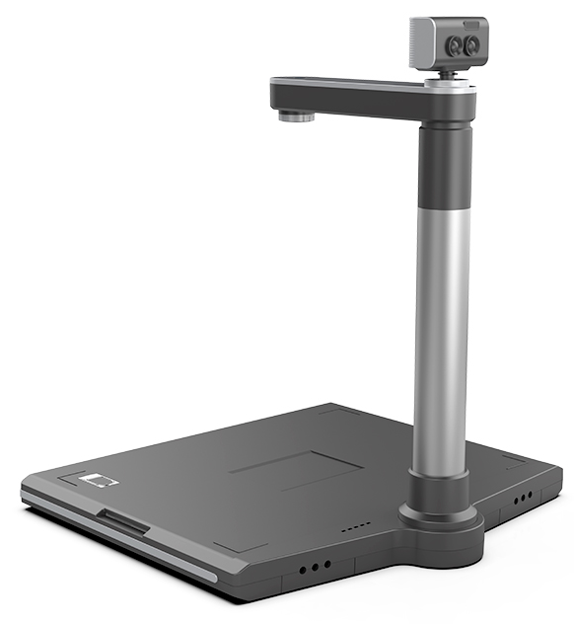
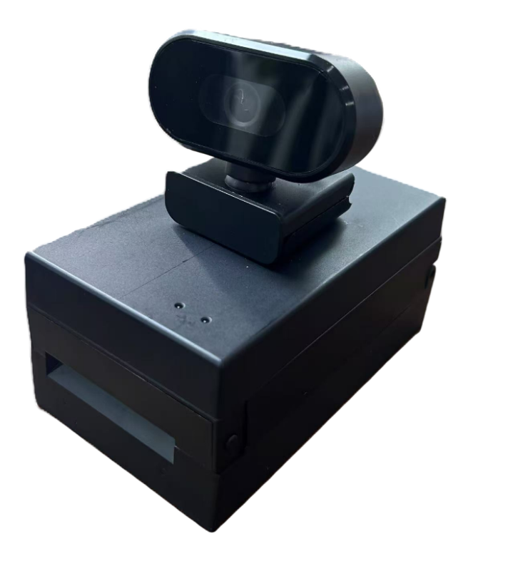
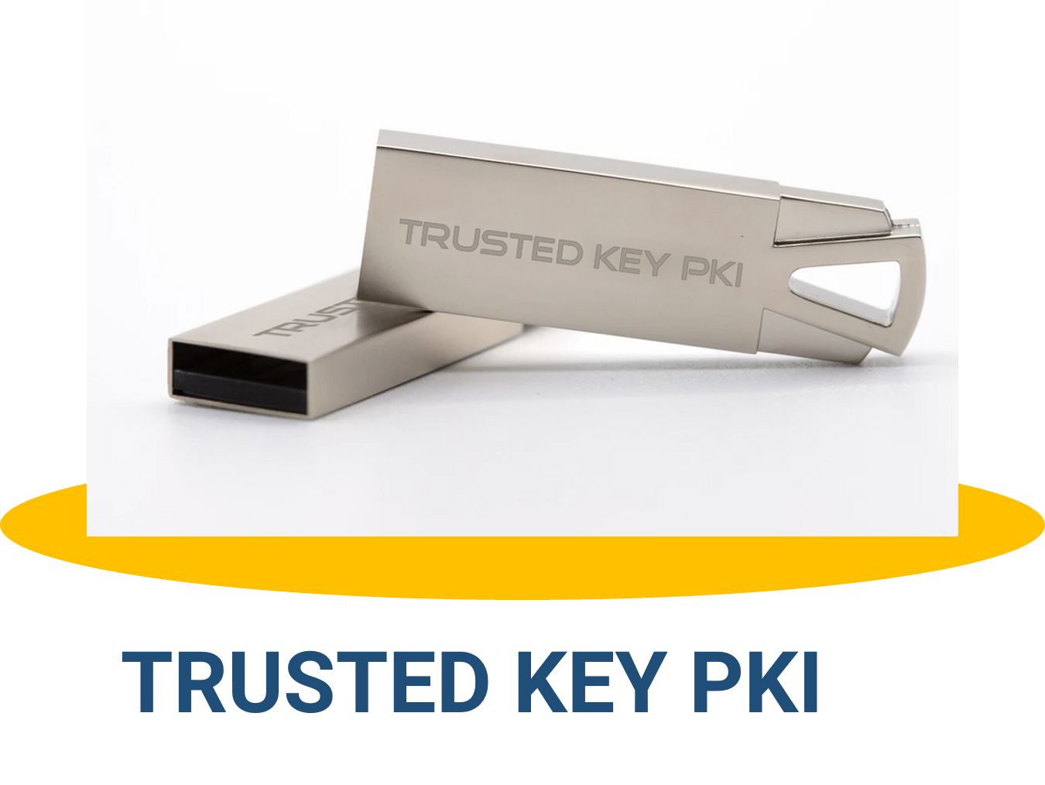
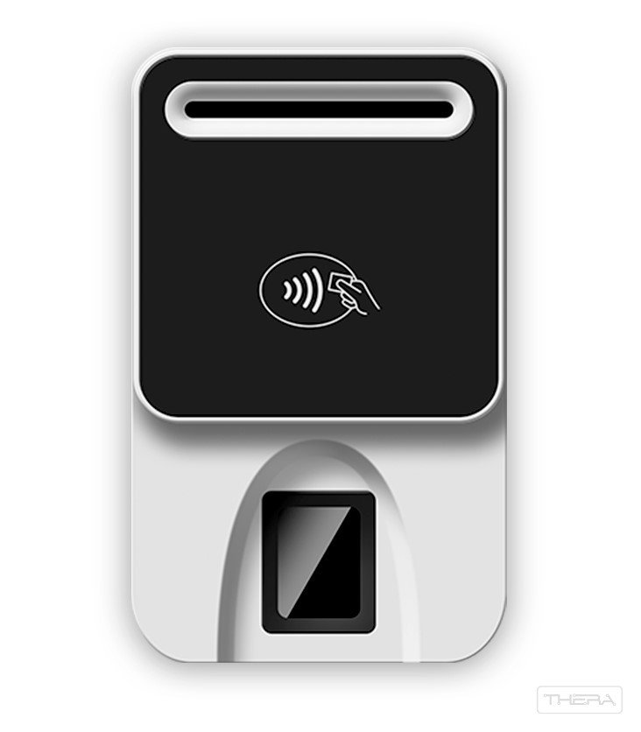
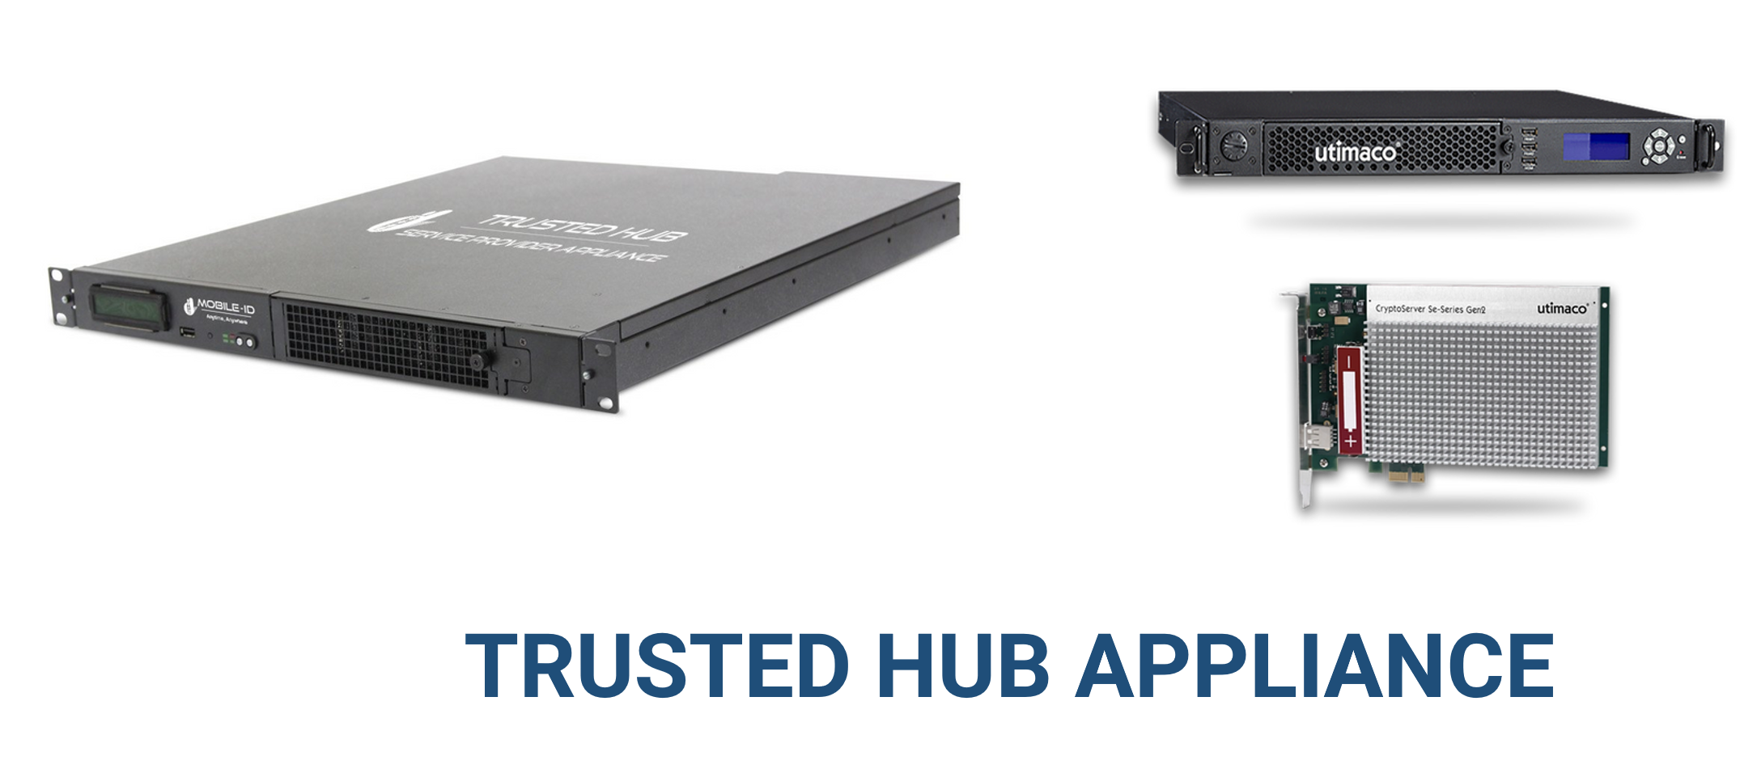
APPLIANCE PROVIDER
CHECKID-SR
BioR502-MRZ
BioR502
Notes:
Ngoài cung cấp dịch vụ về phần mềm, Mobile-ID còn là nhà cung cấp các thiết bị phục vụ cho quá trình thực hiện ký số: USB Token, các sản phẩm thiết bị Card Reader, bộ ký số tập trung Trusted Hub Service Provider Appliance QSCD.

Slide 31





MOBILE-ID TECHNOLOGIES & SERVICES JOINT STOCK COMPANY
Level 9, Thuy Loi 4 Building, 286-288 Nguyen Xi Street, Binh Loi Trung Ward, HCM City, Vietnam
028 3622 2982
info@mobile-id.vn

